Slide 1
Predicting Breast Cancer
Group 2-05:
Ian Huber, Justin Snyder,
Jiacheng Song, Rebecca Wood

Slide 2
Background Information
New methodology in breast cancer testing
Spearheaded by Dr. Wolberg,
Prof. Olvi Mangasarian and Nick Street
Research Source - UC Irvine ML Repository
Notes:
https://www.kaggle.com/uciml/breast-cancer-wisconsin-data

Slide 3
What Is Our Data
Our values are derived from images of fine-needle aspirations (FNA)
Because FNA collects very few cells, risks missing the malignant ones.
Xcyt: User identifies nuclei boundaries, active contour modeling, aka ‘Snakes,’ generates measurements

Slide 4
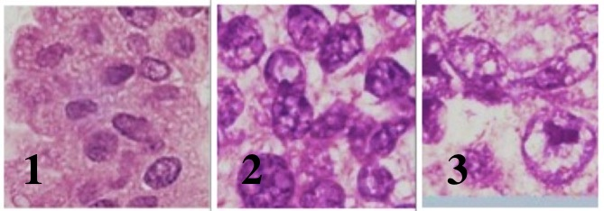
Grading of Invasive Ductal Carcinoma
1: Disorganized cells with enlarged nuclei; few mitoses
2: Larger nuclei, which are ‘bubbled’ or ‘folded’
3: Irregularly shaped, atypical nuclear mitoses

Slide 5
Features Computed
a) Radius (mean of distances from center to points on the perimeter)
b) Texture (standard deviation of gray-scale values)
c) Perimeter
d) Area
e) Smoothness (local variation in radius lengths)
f) Compactness (perimeter^2 / area - 1.0)
g) Concavity (severity of concave portions of the contour)
h) Concave points (number of concave portions of the contour)
i) Symmetry
j) Fractal dimension ("coastline approximation" - 1)

Slide 6
Data Set Information
Kaggle.com data download
Data cleansing (binary values)
Removal of PatientID data
3 subsets of 10 characteristics
Mean Values
Standard Error Values
Worst Case Values

Slide 7
Predictor Discussion
Best Subset Selection
Fit least squares regression for each possible combination
Pick the best among each combination (R2, RSS)
Pick the single best among the best, based on cross-validation prediction error (Cp), BIC, or adjust R2

Slide 8
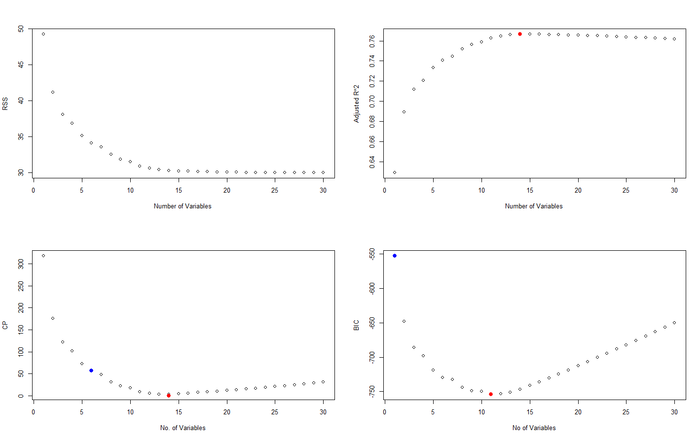

Slide 9
Which to Use?
Best subset selection showed 11 or 14 predictors would be the best for a model prediction
Decided to model with LDA, QDA, and KNN comparing 11 to 14 models

Slide 10
Predictors
11 Predictors
Mean compactness
Mean concavity
Standard error of radius
Standard error of smoothness
Standard error of concavity
Worst radius
Worst texture
Worst area
Worst concave points
Worst symmetry
Worst fractal dimension
14 Predictors
Mean compactness
Mean concavity
Mean radius
Mean concave points
Standard error of radius
Standard error of smoothness
Standard error of concavity
Standard error of concave points
Worst radius
Worst texture
Worst area
Worst symmetry
Worst concavity
Worst fractal dimension

Slide 11
LDA Result
 | LDA with 11 predictors | LDA with 14 predictors
Successful predict rate | 0.9652632 | 0.9639474
Type I error | 0.007423572 | 0.005922423
Type II error | 0.08047371 | 0.08650225
Power | 0.9195263 | 0.9134977
Precision | 0.9866960 | 0.9894824

Slide 12
QDA Result
 | QDA with 11 predictors | QDA with 14 predictors
Successful predict rate | 0.9621930 | 0.9561404
Type I error | 0.027867582 | 0.031506640
Type II error | 0.05501436 | 0.06444136
Power | 0.9449856 | 0.9355586
Precision | 0.9538830 | 0.9473389

Slide 13
KNN Result
 | KNN with 11 predictors | KNN with 14 predictors
Successful predict rate | 0.9228070 | 0.9222807
Type I error | 0.038802827 | 0.038710674
Type II error | 0.14219455 | 0.14358575
Power | 0.8578055 | 0.8564143
Precision | 0.9321513 | 0.9318533

Slide 14

Interpretation of Results
Can predict malignant and benign cancers with approximately 96% accuracy using LDA and QDA classification.
Eleven best predictors:
Mean compactness
Mean concavity
Standard error of radius
Standard error of smoothness
Standard error of concavity
Worst radius
Worst texture
Worst area
Worst concave points
Worst symmetry
Worst fractal dimension
Demonstrate possibility of successfully predicting malignancy of breast cancer in patient.

Slide 15
Interpretation Cont’
Compare our 96% accuracy with researcher’s 97% accuracy
They used PCA
Warning!
Inaccuracies were false negatives, which can have disastrous consequences for patients

Slide 16
What We Learned
Put into practice ideas learned throughout year, such as KNN, LDA, QDA, and best subset selection
Better to iterate tests multiple times and find average of the tests

Slide 17

Going Forward...
Results demonstrate that measurements of sampled cells can predict malignancy of breast cancer
Previous method was subjective interpretation by oncologist
Now have objective data to back up diagnosis.
Use results to guide medicinal procedure that determines malignancy
Know that some cases will be misdiagnosed, most likely as benign
With that knowledge, instruct medical professionals to double check their measurements if they yield benign

Slide 18
Back-Up Slides

Slide 19
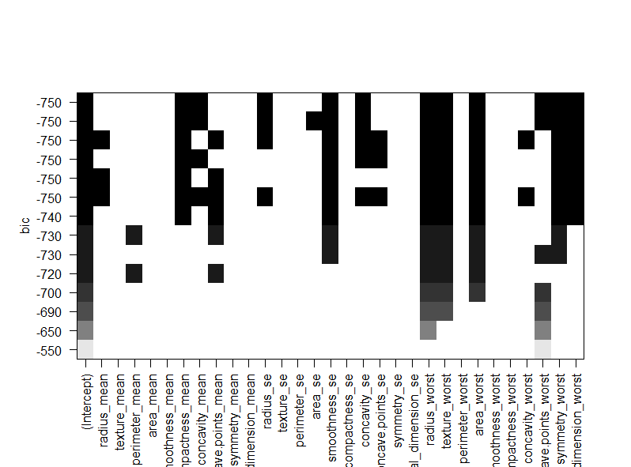

Slide 20
